Slide 1
Performance Tuning
C393: Database Systems

Slide 2
Review

Slide 3
Lesson Objectives
Analyze and improve query performance
Describe how a database index works

Slide 4
A little bit of data…
IMDb Non-Commercial Datasets
~11 million titles
~14 million names
~1.5 million ratings

Slide 5
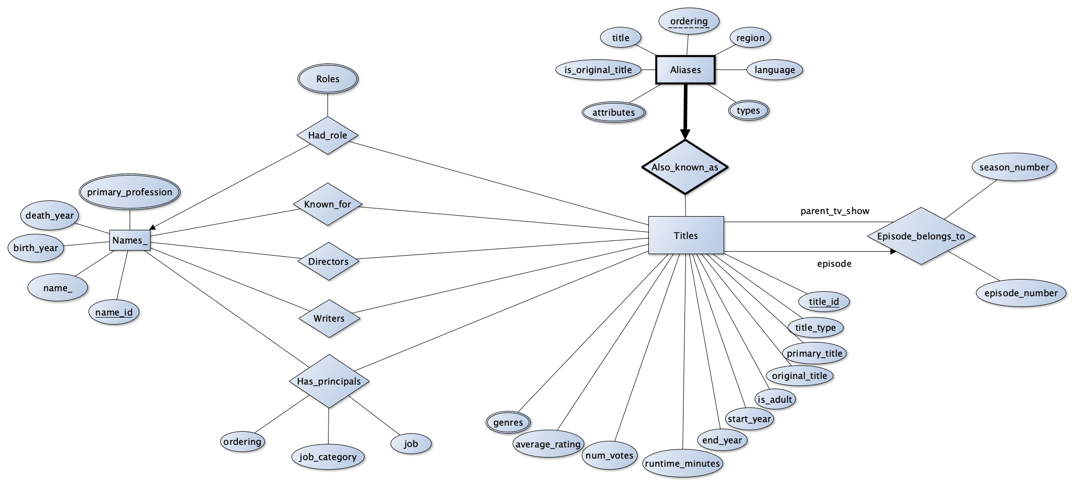
IMDB Design
Notes:
https://github.com/dlwhittenbury/MySQL_IMDb_Project

Slide 6
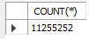
…goes a long way
13:45:09 SELECT COUNT(*) FROM title_basics
1 row(s) returned 3.328 sec / 0.000 sec
Even basic operations can take some time…

Slide 7
Query Speed
SELECT primaryTitle, startYear, genres FROM title_basics WHERE startYear = 2020 AND titleType = 'movie’ LIMIT 10;
16493 row(s) returned 1.704 sec / 0.000 sec
Notes:
Query speed here is 1.704 seconds. Transfer time is 0.000 seconds.

Slide 8
Transfer Speed
SELECT primaryTitle, startYear, genres FROM title_basics WHERE startYear = 2020 AND titleType = 'movie’ LIMIT 10;
16493 row(s) returned 1.704 sec / 12.578 sec
Notes:
There is a difference between how long the query takes (find the right data) versus how long it takes to transfer the data (in memory or over the wire)

Slide 9
Indexing

Slide 10
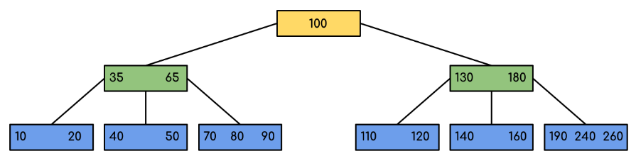
What is indexing?
An index is a data structure that stores information in a particular way such that it…
Is quick to search
Is quick to update
Is quick to insert
Notes:
The image shown is a B-tree

Slide 11
Properties of B-Trees
Time complexity:
O(log n) searches
O(log n) inserts
O(log n) deletes
Very useful for exact and range searches
How many steps does it take to find 80?
What about all values > 150?
All values < 100?
Notes:
Log(15 million) ~= 7.2

Slide 12
Back to an Example…
SELECT primaryTitle, startYear, genres FROM title_basics WHERE startYear = 2020 AND titleType = 'movie’ LIMIT 10;
16493 row(s) returned 1.704 sec / 0.000 sec
Notes:
This is without an index

Slide 13
Creating the index
CREATE INDEX idx_startYear ON title_basics(startYear)
0 row(s) affected Records: 0 Duplicates: 0 Warnings: 0
52.829 sec
SELECT primaryTitle, startYear, genres FROM title_basics WHERE startYear = 2020 AND titleType = 'movie’ LIMIT 10;
14:14:16
10 row(s) returned 0.016 sec / 0.000 sec
Notes:
A 100x improvement!

Slide 14
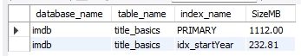
Why don’t we index all the things?
Adds additional insert / update time
Take up space!!!
Original title_basics table from IMDB was <1GB large (uncompressed)

Slide 15
Another Example
SELECT tb.primaryTitle, tr.averageRating, tr.numVotes
FROM title_basics tb
JOIN title_ratings tr ON tb.tconst = tr.tconst
WHERE tb.titleType = 'movie'
ORDER BY tr.averageRating DESC, tr.numVotes DESC
LIMIT 10;
10 row(s) returned 3.500 sec / 0.000 sec

Slide 16

What took so long?

Slide 17
EXPLAIN yourself
EXPLAIN
SELECT tb.primaryTitle, tr.averageRating, tr.numVotes
FROM title_basics tb
JOIN title_ratings tr ON tb.tconst = tr.tconst
WHERE tb.titleType = 'movie'
ORDER BY tr.averageRating DESC, tr.numVotes DESC
LIMIT 10;
Notes:
First MySQL grabs all records from the ratings table
Then grabs the corresponding record from the basics table
Then does the sorts
Notice no key on the first query… (key = index)

Slide 18
Improve performance
Add index on order by attributes…
CREATE INDEX idx_best ON title_ratings(averageRating, numVotes);
SELECT tb.primaryTitle, tr.averageRating, tr.numVotes
FROM title_basics tb
JOIN title_ratings tr ON tb.tconst = tr.tconst
WHERE tb.titleType = 'movie'
ORDER BY tr.averageRating DESC, tr.numVotes DESC
LIMIT 10;
10 row(s) returned 0.328 sec / 0.000 sec
Notes:
Same query but with index on order by attributes, notice here the explain statement has a key for both steps

Slide 19
Other Options

Slide 20
A New Contender
SELECT startYear, COUNT(*) AS movie_count FROM ( SELECT startYear FROM title_basics WHERE titleType = 'movie’ AND startYear BETWEEN 2000 AND 2020 ) filtered GROUP BY startYear ORDER BY movie_count DESC LIMIT 5;
5 row(s) returned 586.328 sec / 0.000 sec
Notes:
I believe the struggle with this one is that the index no longer exists in the temporary table that is created by the inner subquery, so that the count takes longer to compute with no index available

Slide 21
Restructure the Query
SELECT startYear, COUNT(*) AS movie_count FROM title_basics tb WHERE tb.titleType = 'movie’ AND tb.startYear BETWEEN 2000 AND 2020 GROUP BY startYear ORDER BY startYear DESC LIMIT 5;
5 row(s) returned 157.984 sec / 0.000 sec
Notes:
This one counts faster because there is already an index on startYear

Slide 22
Create a Summary Table
CREATE TABLE movies_per_year AS SELECT tb.startYear, COUNT(*) AS movie_count FROM title_basics tb WHERE tb.titleType = 'movie' AND tb.startYear IS NOT NULL GROUP BY tb.startYear;
137 row(s) affected Records: 137 Duplicates: 0 Warnings: 0 1150.140 sec
Must update this table when new records are inserted / updated /deleted
SELECT * FROM movies_per_year ORDER BY startYear DESC 137 row(s) returned 0.000 sec / 0.000 sec

Slide 23
(De-)Normalization
SELECT COUNT(*) FROM title_basics WHERE genres LIKE '%action%’;
1 row(s) returned 16.890 sec / 0.000 sec
After 11 hours of normalizing…

Slide 24
Recap
Create an index
Restructure the query
Normalize / denormalize
Create a summary table
Time vs space optimization problem
Can also optimize inserts, reads, updates separately

